Slide 1
C# for test automation
Final assignment
Module 9

Slide 2
Agenda
Preparation and background information
Unit testing tasks
SpecFlow introduction
SpecFlow tasks

Slide 3
FINAL ASSIGNMENT
OVERVIEW
Goal
The main purpose of this module is to review and consolidate the knowledge gained throughout the course
Tasks
Unit tests using Moq and Shouldly
Consider advanced level task:
Integration testing using SpecFlow approach

Slide 4
FINAL ASSIGNMENT
preparation
Before the start, please create the new workspace in TRAIN-CS08 installation. Your solution should consist of at least seven projects:
      IMS.Course.CurrencyConverter
      IMS.Course.CurrencyConverter.Application
      IMS.Course.CurrencyConverter.Application.Test
      IMS.Course.CurrencyConverter.GUI
      IMS.Course.CurrencyConverter.GUI.IntegrationTest
      IMS.Course.CurrencyConverter.Infrastructure
      IMS.EntryPoint
Please start the installation in marshaller mode

Slide 5
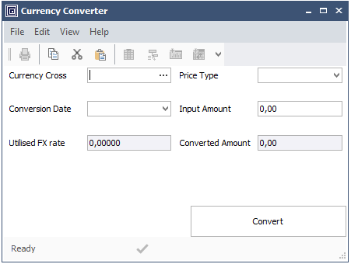
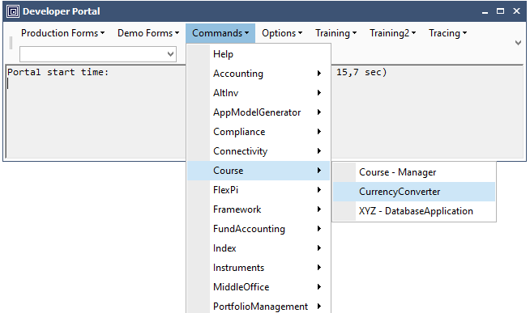
FINAL ASSIGNMENT
preparation
Build and start your solution without debugging (Ctrl-F5)
Try to launch the “CurrencyConverter” form from the Developer Portal – Commands → Course → CurrencyConverter

Slide 6
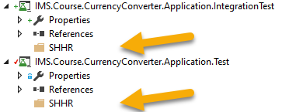
FINAL ASSIGNMENT
Unit testing task: L0 test
New unit tests should be added to existing IMS.Course.CurrencyConverter.Application.Test project.
Place the new unit test class in folder named with your initials.
CurrencyConversionService class should be covered with a proper L0 unit tests.
Test that exceptions is thrown when currency cross does not exist
Test that exception is thrown when the exchange rate does not exist
Test that the result is calculated according to input amount and exchange rate
Test that the result is rounded by 2 decimal places
Make sure that all data repositories called from CurrencyConversionService are mocked.
Please verify number of method calls for each repository.
Check-in your changes and ask your coach for a code review.

Slide 7
FINAL ASSIGNMENT
Specflow basics
What is SpecFlow?
Opensource tool for “bringing the communication gap between domain experts and developers”
Allows non-technical people (POs) to write acceptance tests for a system
Enables these acceptance tests to be automated and the acceptance tests “executed” against the system
Acceptance test:
Validates that the right system is being built | Business/user/customer point of view
When automated, becomes “living documentation” | Written in non-technical format
Usually execute a vertical slice of the system | Helps to define shared understanding what ‘done’ means
Pass/fail
Notes:
Procedural Programming based upon the concept of the procedure call, simply contain a series of computational steps to be carried out. Any given procedure might be called at any point during a program’s execution, including by other procedures or itself. Major procedural programming languages are COBOL, BASIC, C, ADA and GO
Object Oriented Programming based on the concept of objects, which contains data(attributes) and procedures(methods). This pattern is more closer to Functional Programming. Significant object-oriented languages include C++, Java, PHP, C#, Python, Ruby, Swift etc.

Slide 8
FINAL ASSIGNMENT
Specflow basics. structure
Feature file
Scenario
Scenario
Scenario
Step
Step
Step
Visual Studio
Test code
Test code
Test code
Business readable language (Gherkin)
Testing framework
Source: Pluralsight

Slide 9
FINAL ASSIGNMENT
Specflow basics. feature
What should be a new feature?
A feature is a desired product functionality often involving multiple behaviors.
Don’t overthink. The main distinction between a feature and a scenario or behavior is that features are what customers expect to receive – POs already defined them.
Features should be determined by customer needs. They should solve problems the customers have.
Source: https://automationpanda.com/2017/10/19/in-bdd-what-should-be-a-feature/
Notes:
Strat with “Feature” keyword, followed by Name and optional free text description (to provide information regarding the test content)

Slide 10
FINAL ASSIGNMENT
Specflow basics. Feature structure
Contain one or more scenarios
Group/contain logically related test scenarios
Represent small, discrete features of the system
Start with “Feature: “ keyword
Followed by feature name/terse description
Optional free text description
  Feature: Brush Teeth
  Brushing teeth is good
  because it helps keep
  them clean
Feature name
Optional description
Source: Pluralsight

Slide 11
FINAL ASSIGNMENT
Specflow basics. Optional feature formats
As a… I want… So that….
  Feature: Brush Teeth
  As a human
  I want to brush my teeth
  So that they stay pain free
In order to… As a…. I want….
Role/person centric
  Feature: Brush Teeth
  In order to stay pain free
  As a human
  I want to brush my teeth
Value centric
Source: Pluralsight

Slide 12
FINAL ASSIGNMENT
Specflow basics. Scenario
What should be a new scenario?
A scenario is the specification of a behavior using formal steps and examples.
A scenario describes a particular situation with one expected behavior of the system. Should be independent and isolated
Scenario characteristics:
Concrete examples of expected system behaviour
Each scenario describes a particular situation
Each scenario should be independent and isolated
Can present:
  ”Happy” path
  Error path
  Edge cases
Start with: ”Scenario: ” keyword
Followed by title
Source: https://automationpanda.com/2017/10/19/in-bdd-what-should-be-a-feature/
Notes:
Strat with “Feature” keyword, followed by Name and optional free text description (to provide information regarding the test content)

Slide 13
FINAL ASSIGNMENT
Specflow basics. Scenarios steps
  Scenario: Successful brushing
Set up initial state
  Given there is toothpaste on the brush
And the mouth is open
Given
(Context)
Perform action(s)
  When the back teeth are brushed
  And the front teeth are brushed
When
(Event)
Check end state
  Then the teeth look clean
  And the mouth feels fresh
Then (Outcome)
Source: Pluralsight

Slide 14
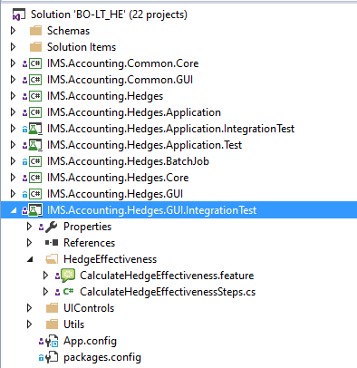
FINAL ASSIGNMENT
Specflow basics. Examples
IMS.Accounting.Hedges.GUI.IntegrationTest
Feature: CalculateHedgeEffectiveness
As a user I want to be able to use Calculate Hedge Effectiveness form
in order to get Hedge Effectiveness values
@GivenByBrick
Scenario: CalculateHedgeEffectiveness_1
As a user I want to be able to press Clear button so that is recognised by the system
Given existing hedge setup is launched in Calculate Hedge Effectiveness form
When user clicks 'Clear' button under 'File' menu
Then 'HedgeID' field is empty
[Given(@"existing (.*) setup is launched in Calculate Hedge Effectiveness form")]
public void GivenExistingSetupIsLaunchedInCalculateHedgeEffectivenessForm(string name) {
Trace.WriteLine("----- Bricks are about to start running");
BrickDataHelper.GenerateBrickDataDictionary(Bricks.HedgeFreeze, 1);
Trace.WriteLine($"----- Bricks were successfully initialized, with setup name:
{BrickDataHelper.GetFieldValueFromBrickDataDictionary(name)}");
Form = HedgeEffectivenessForm.Launch();
Form.HedgeID.SetValueAndValidate(BrickDataHelper.GetFieldValueFromBrickDataDictionary(name));
Form.WaitForApplicationState("Update");
}
[When(@"user clicks '(.*)' button under '(.*)' menu")]
public void WhenUserClicksButtonUnderMenu(string buttonName, string menuName) {
Form.MenuBar.MenuItems[menuName].Buttons[buttonName].Click();
Wait.Until(() => Form.IsReady, TimeInterval.ShortMedium);
}
[Then(@"'(.*)' field is empty")]
public void ThenFieldIsEmpty(string fieldName) {
var fieldControl = Form.GetType().GetProperty(fieldName)?.GetValue(Form);
var fieldControlValue = fieldControl?.GetType().GetProperty("Value")?.GetValue(fieldControl);
UIAssert.AreEqual("", fieldControlValue, $"'{fieldName}' field is not empty");
}

Slide 15

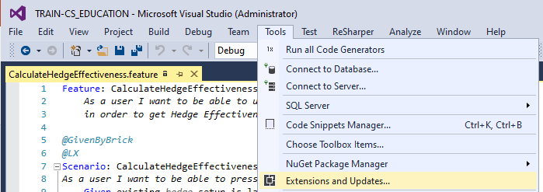
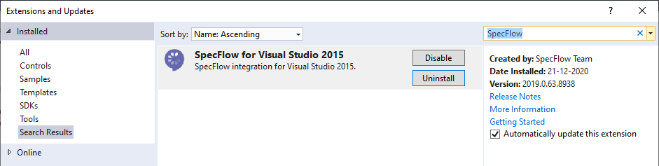
FINAL ASSIGNMENT
SpecFlow tasks. PREPARATION
Make sure that you have installed SpecFlow extension for Visual Studio.
Please restart Visual Studio after the extension installation.
Notes:
Procedural Programming based upon the concept of the procedure call, simply contain a series of computational steps to be carried out. Any given procedure might be called at any point during a program’s execution, including by other procedures or itself. Major procedural programming languages are COBOL, BASIC, C, ADA and GO
Object Oriented Programming based on the concept of objects, which contains data(attributes) and procedures(methods). This pattern is more closer to Functional Programming. Significant object-oriented languages include C++, Java, PHP, C#, Python, Ruby, Swift etc.

Slide 16
FINAL ASSIGNMENT
SpecFlow tasks
New integration tests should be added to IMS.Cource.CurrencyConverter.Application.IntegrationTest project.
Place the new files in folder named with your initials.
Scenario: CurrencyConversion_1
As a user, I want to be sure that an error message appears if the Currency Cross field is empty after clicking the Convert button.
  Given Currency Converter form is launched, and all necessary fields are populated with values
  When ‘Currency Cross' field is empty
  And User press ‘Convert’ button
  Then Error message appears ‘Currency Cross cannot be empty’
Check-in your changes and ask your coach for a code review.
Notes:
Procedural Programming based upon the concept of the procedure call, simply contain a series of computational steps to be carried out. Any given procedure might be called at any point during a program’s execution, including by other procedures or itself. Major procedural programming languages are COBOL, BASIC, C, ADA and GO
Object Oriented Programming based on the concept of objects, which contains data(attributes) and procedures(methods). This pattern is more closer to Functional Programming. Significant object-oriented languages include C++, Java, PHP, C#, Python, Ruby, Swift etc.

Slide 17
FINAL ASSIGNMENT
SpecFlow tasks
Scenario: CurrencyConversion_3
As a user, I want to be sure that Clear shortcut (Ctrl + R) clears all data from the input and output fields on the form.
  Given Currency Converter form is launched, and initial exchange rate data exists
  When User press ‘Convert’ button
  And User press ‘Ctrl + R’ combination
  Then All fields are empty
Check-in your changes and ask your coach for a code review.
Notes:
Procedural Programming based upon the concept of the procedure call, simply contain a series of computational steps to be carried out. Any given procedure might be called at any point during a program’s execution, including by other procedures or itself. Major procedural programming languages are COBOL, BASIC, C, ADA and GO
Object Oriented Programming based on the concept of objects, which contains data(attributes) and procedures(methods). This pattern is more closer to Functional Programming. Significant object-oriented languages include C++, Java, PHP, C#, Python, Ruby, Swift etc.

Slide 18
FINAL ASSIGNMENT
SpecFlow tasks. ADVANCED
Scenario: CurrencyConversion_2
As a user, I want to be sure that conversion result is displayed after clicking the Convert button.
  Given Currency Converter form is launched, and initial exchange rate data exists
  When User press ‘Convert’ button
  Then ‘Converted Amount’ field is not empty
Check-in your changes and ask your coach for a code review.
Notes:
Procedural Programming based upon the concept of the procedure call, simply contain a series of computational steps to be carried out. Any given procedure might be called at any point during a program’s execution, including by other procedures or itself. Major procedural programming languages are COBOL, BASIC, C, ADA and GO
Object Oriented Programming based on the concept of objects, which contains data(attributes) and procedures(methods). This pattern is more closer to Functional Programming. Significant object-oriented languages include C++, Java, PHP, C#, Python, Ruby, Swift etc.

